Slide 1

Web scraping to gain company insights
19/10/2023

Slide 2
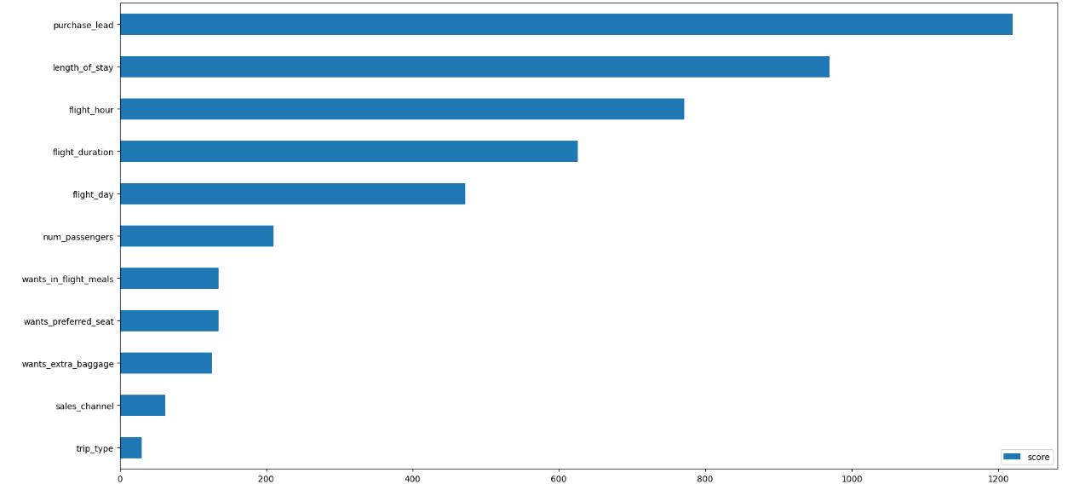
predictive model to understand factors that influence buying behavior
We have trained the data set with XGBoost Classifier Model and received
ACCURACY: 0.80
AUC score: 0.55
Purchase_land
Length_of_stay
flight_hour
flight_duration
flight_day
These are the top 5 features which influence
Customer buying behavior

